Slide 1
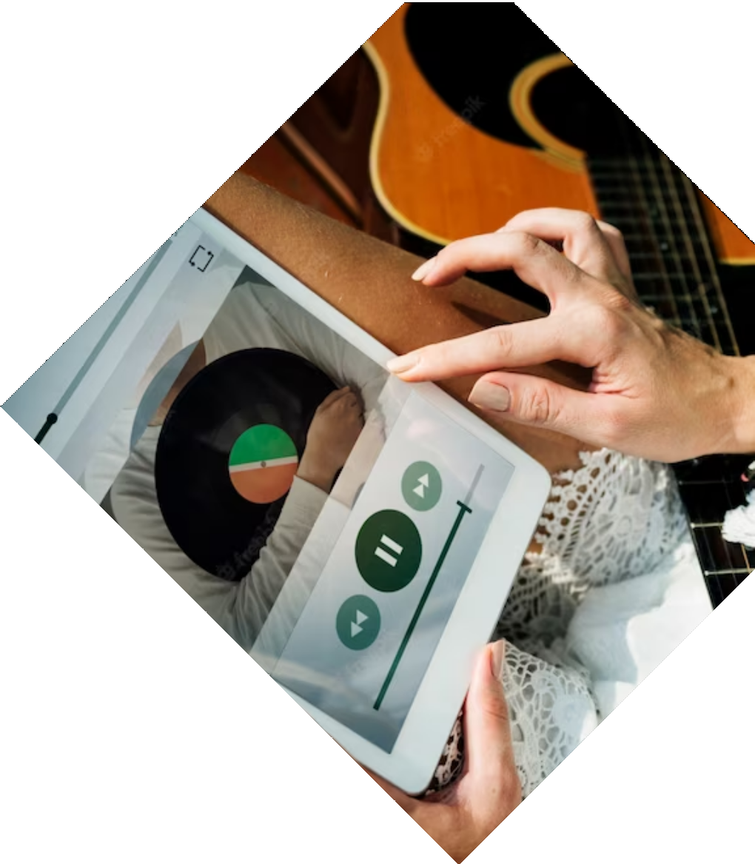

Unleashing the Beat: Exploring the Spotify Clone Phenomenon

Slide 2
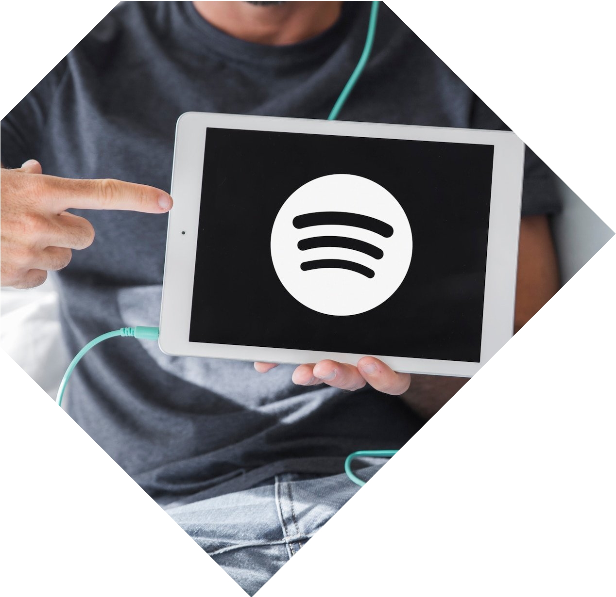


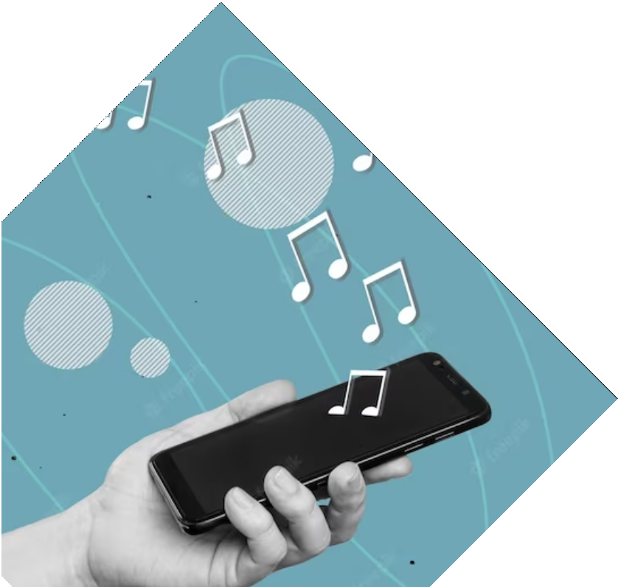
Introduction
Unleashing the Beat: Exploring the Spotify Clone Phenomenon
In this presentation, we will delve into the
world of Spotify clones, examining their rise in popularity and the impact they have had on the music industry. We will explore the features and beneﬁts of these clones and discuss their inﬂuence on user behavior and music consumption.

Slide 3

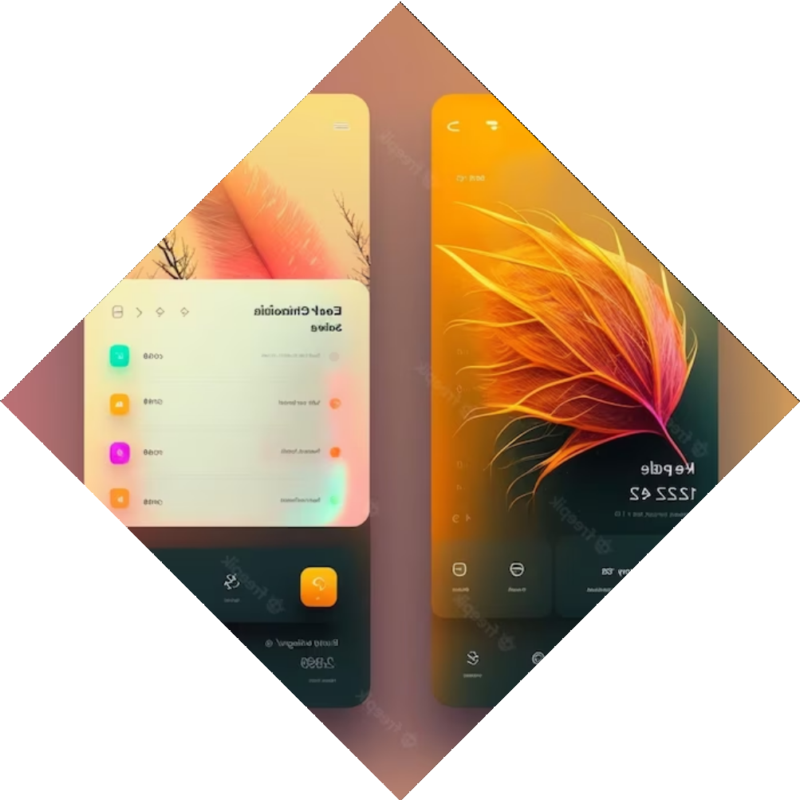
What is a Spotify Clone?
A Spotify clone is a music streaming platform that emulates the features and functionalities of the original Spotify application. These clones offer a similar user experience, allowing users to discover, stream, and create playlists of their favorite songs. With a vast library of music, intuitive interfaces, and personalized recommendations, Spotify clones have revolutionized the way people access and enjoy music.

Slide 4


The Rise of Spotify Clones
The rise of Spotify clones can be attributed to the increasing demand for convenient and affordable music streaming services. These clones have gained popularity due to their accessibility, extensive music catalogs, and seamless integration with other devices. They have disrupted traditional music distribution channels, enabling users to explore a diverse range of genres and artists from anywhere, anytime.

Slide 5
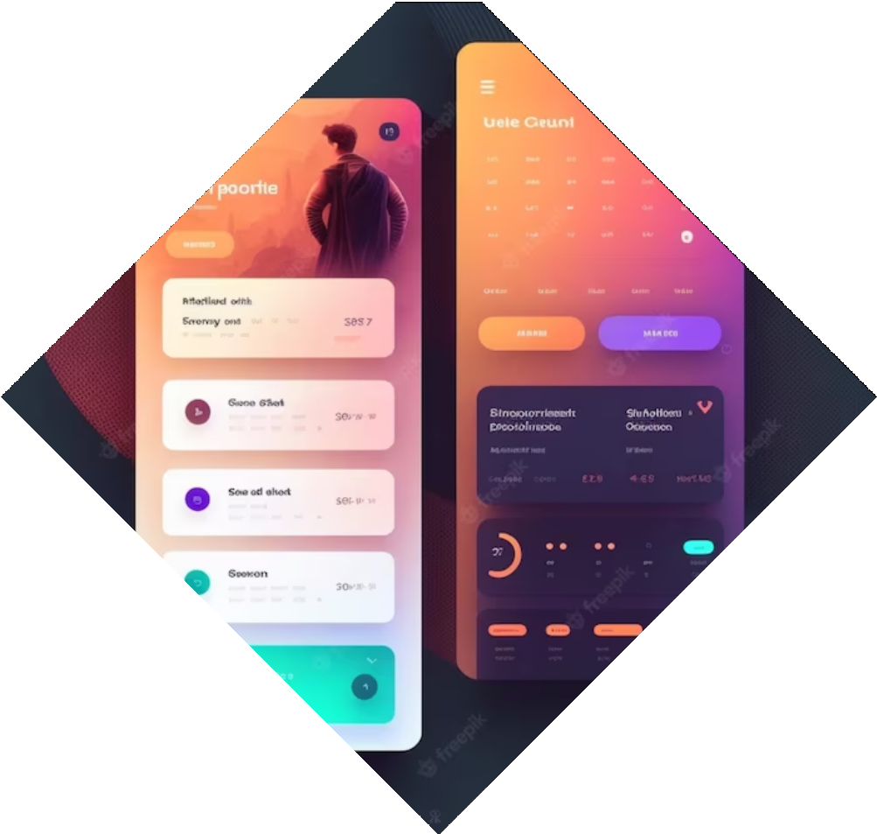

Features of Spotify Clones
Spotify clones offer a range of features that enhance the music streaming experience.
These include personalized playlists, algorithmic recommendations, ofﬂine downloading, social sharing, and cross- platform synchronization. Users can explore curated playlists, discover new artists, and enjoy high-quality audio streaming.
Additionally, Spotify clones often provide interactive features like lyrics display, concert notiﬁcations, and collaborative playlist creation.

Slide 6


Impact on the Music Industry
The impact of Spotify clones on the music industry has been profound. They have facilitated the democratization of music, enabling independent artists to reach wider audiences and receive fair compensation. These clones have also inﬂuenced music consumption patterns, shaping popular trends and fostering a culture of music discovery. However, they have posed challenges to traditional revenue models and raised concerns regarding artist royalties
and copyright protection.

Slide 7
Conclusion
In conclusion, the rise of Spotify clones has revolutionized the way people engage with music. These clones have provided users with unprecedented access to a vast music library and personalized recommendations. While they have disrupted traditional music distribution channels, they have also opened doors for independent artists and reshaped music consumption patterns. As the popularity of Spotify clones continues to grow, it is essential to address the challenges they present and ensure a fair and sustainable music ecosystem.

Slide 8
Thanks
Do you have any questions?

